Slide 1

SECD2523 DATABASE
TOPIC 6B | LOGICAL DATABASE DESIGN
Content adapted from Connolly, T., Begg, C., 2015. Database Systems: A Practical Approach to Design, Implementation, and Management, Global Edition. Pearson Education.

Slide 2
LECTURE LEARNING OUTCOME
By the end of this lecture, students should be able to:
01
Define the purpose of normalization and how it supports database design
02
Identify potential problems associated with relational database design (data redundancy and update anomalies)
03
Define functional dependency and its association with normalization
04
Identify functional dependencies for a given relation
05
Define 1NF, 2NF, 3NF and BCNF
06
Perform normalization up until BCNF

Slide 3
Normalization
A technique for producing a set of relations with desirable properties, given the data requirements of an enterprise.
The purpose of normalization is to identify a suitable set of relations that support the data requirements of an enterprise.
The characteristics of a suitable set of relations include the following:
  the minimal number of attributes necessary to support the data requirements of the enterprise.
  attributes with a close logical relationship (describes as functional dependency) are found in the same relation.
  minimal redundancy with each attribute represented only once with the important exception of attributes that form all or part of foreign keys, which are essential for the joining of related relations.

Slide 4
Benefit of Normalization
Minimize data redundancies in a database, thus will reduce storage space required to store the data
Reduce data anomalies
Easy for user to access data from a database
Easy for user to maintain data

Slide 5
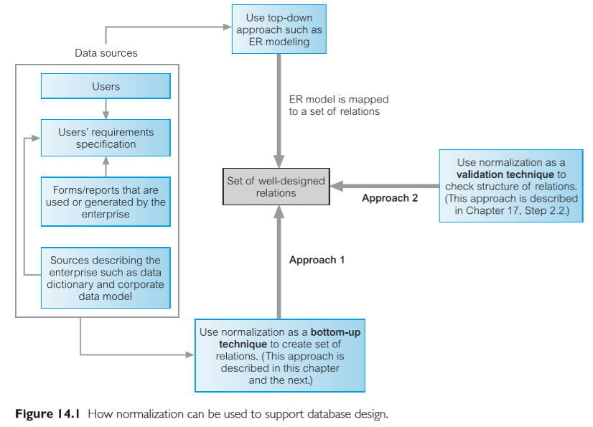
How Normalization Supports Database Design
2 approaches for using normalization:
  Approach 1 – normalization can be used as a bottom-up standalone database design technique.
  Approach 2 – normalization can be used as a validation technique to check the structure of relations, using a top-down approach such as ER modeling.

Slide 6
PART 1: DATA ANOMALIES
INTRODUCTION
PART 1
DATA REDUNDANCIES & ANAMOLIES
PART 2
DEPENDENCIES
PART 3
FIRST NORMAL FORM
PART 4
SECOND NORMAL FORM
PART 5
THIRD NORMAL FORM
PART 6
BOYCE-CODD NORMAL FORM

Slide 7
Before we start…
Need to understand two concepts:
1) DATA REDUNDANCY
2) UPDATE ANOMALIES

Slide 8
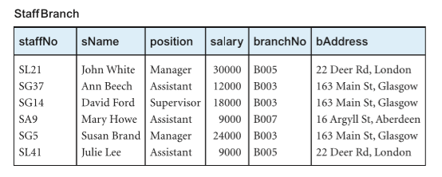
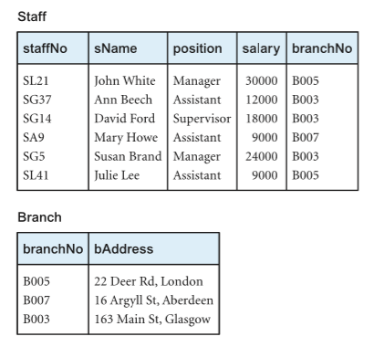
To understand the two concepts, we will be referring to the situation below:
VS
Situation 1
Situation 2
Both information of staffs and branch are in StaffBranch relation
Information of staffs in Staff relation
Information of branch in Branch relation

Slide 9
1) DATA REDUNDANCY
Data redundancy = repeated details for the same data
To minimize data redundancy group attributes into relations in Relational Database (RD).
This would give benefits for the implemented database, such as:
  Minimal number of operations when update data
  Reduce the opportunities for data inconsistencies
  Reduce file storage and minimize costs
Situation 1
Both information of staffs and branch are in StaffBranch relation

Slide 10
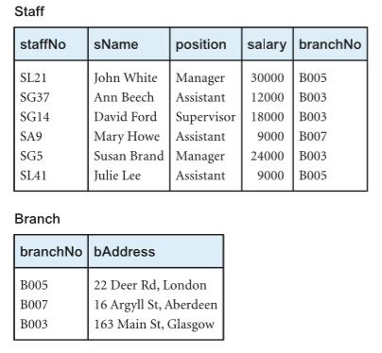
1) DATA REDUNDANCY
However, certain amount of data redundancy is required in Relational Databases
  copies of Primary Keys (or candidate keys) acting as Foreign Keys in related relations to enable the modeling of relationships between data.
Situation 2
Foreign key
Information of staffs in Staff relation
Information of branch in Branch relation
Primary key

Slide 11
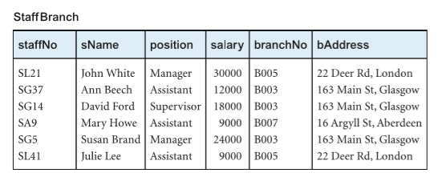
2) UPDATE ANOMALIES
Figure 1
Unwanted data redundancy may cause update anomalies
For update anomalies, we will look at SITUATION 1:
Look at tuples in row 2, 3 and 5. The details of a branch (B003) are repeated for every member of staff located at that branch data redundancy, hence defeat one of the purpose of building a database.
Category of update anomalies :
Insertion anomalies
Deletion anomalies
Modification anomalies

Slide 12
UPDATE ANOMALIES: Insertion Anomalies
There are two main types of insert anomalies:
1: To insert the details of new members of staff into the StaffBranch relation
Anomaly due to the design of the relation that cause difficulties during inserting new data
X
Argyl > Argyll
Our database will show 2 different address for B007!!
SG11 Andy Cole Supervisor 18000 B007 16 Argyl Rd, London

Slide 13
Insertion Anomalies
2) To insert details of a new branch that currently has no members of staff into the StaffBranch relation
Anomaly due to the design of the relation that cause difficulties during inserting new data
X
X
X
X
B009 19A McKeon Ave, London
We defined staffNo is a PRIMARY KEY
PK – entity integrity (NO NULL)

Slide 14
Deletion Anomalies
If we delete a tuple from the StaffBranch relation that represents the last member of staff located at a branch, the details about that branch are also lost from the database.
We will also delete B007 data (unwanted data loss) because the Branch still exist!!
Anomaly due to the design of the relation that cause difficulties during deletion of data. Might cause unwanted data loss.

Slide 15
Modification Anomalies
If we want to change the value of one of the attributes of a particular branch in the StaffBranch relation—for example, the address for branch number B003
Anomaly due to the design of the relation that cause difficulties during modification of existing data. Might lead to inconsistency of the database.
Accidently forgot to update.
Now we have 2 different address for B003!!
B003 19 McKeon Ave, London
B003 19 McKeon Ave, London

Slide 16

You should understand
1) DATA REDUNDANCY
2) UPDATE ANOMALIES

Slide 17
PART 2: DEPENDENCIES
INTRODUCTION
PART 1
DATA ANAMOLIES
PART 2
DEPENDENCIES
PART 3
FIRST NORMAL FORM
PART 4
SECOND NORMAL FORM
PART 5
THIRD NORMAL FORM
PART 6
BOYCE-CODD NORMAL FORM

Slide 18
Functional Dependencies (FD)
An important concept associated with normalization is functional dependency, which describes the relationship between attributes (Maier, 1983).
  if A and B are attributes of relation R, B is functionally dependent on A (written as: A → B) if each value of A is associated with exactly one value of B. ( A and B may each consist of one or more attributes.)
When a functional dependency is present, the dependency is specified as a constraint between the attributes.
An alternative way → ‘A functionally determines B’

Slide 19
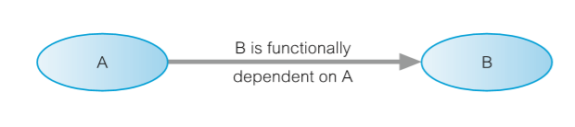
FD: Determinant
Determinant: Refers to the attribute, or group of attributes, on the left-hand side of the arrow of a functional dependency.
determinant

Slide 20
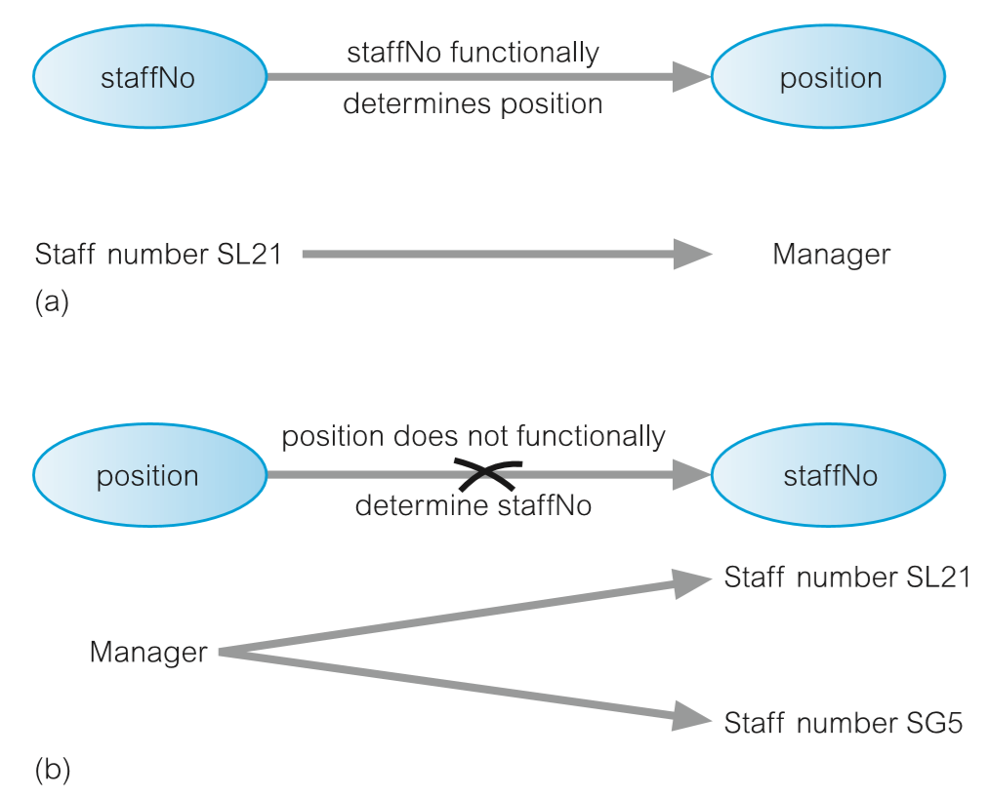
Example of a Functional Dependency
staffNo functionally determines position
  staffNo → position
  Relationship between staffNo and position is 1:1
position does not functionally determine staffNo
  position → staffNo
  relationship between position and staffNo is 1:*
X

Slide 21
Functional Dependencies
In normalization we are only interested in FD that “holds at all time”
Indicate a 1:1 relationship between attributes
The reason is that we want to identify functional dependencies that hold for all possible values for attributes of a relation as these represent the types of integrity constraints that we need to identify.
Approach → by understanding the purpose of each attribute in an identified relation.

Slide 22
FUNCTIONAL DEPENDENCIES [Discussion]
Which of these two FDs hold at all times??
  staffNo attribute functionally determines the sName attribute
    staffNo → sName
  sName attribute functionally determines the staffNo attributes
    sName → staffNo
sName is functionally
staffNo
sName
dependent on staffNo
staffNo is functionally
sName
staffNo
dependent on sName

Slide 23
Functional Dependencies
Characteristics of functional dependencies use in normalization
  One-to-one relationship exists between the attribute(s) on the left-hand side (determinant) and those on the right-had side of a functional dependency.
  They hold for all time
  The determinant has the minimal number of attributes necessary to maintain the dependency with the attribute(s) on the right-hand side → there must be a full functional dependency between the attributes(s) on the left-hand and right-hand sides of the dependency.

Slide 24
Full Functional Dependency
1. Full functional dependency: Indicates that if A and B are attributes of A relation, B is FULLY FUNCTIONALLY DEPENDENT on A if B is functionally dependent on A, but not on any proper subset of A.
StaffBranch ( staffNo, sName, position, salary, branchNo, bAddress)

Slide 25
Full Functional Dependency
2) A functional dependency A🡪B is a FULL FUNCTIONAL DEPENDENCY if removal of any attribute from A results in the dependency no longer existing.

Slide 26
Partial Dependency
A functional dependency A → B is a PARTIAL DEPENDENCY if there is some attribute that can be removed from a and yet the dependency still holds.

Slide 27
Transitive Dependency
A condition where A, B, and C are attributes of a relation such that if A → B and B → C, then C is transitively dependent on a via B (provided that a is not functionally dependent on B or C).

Slide 28
Transitive Dependency
branchNo → bAddress
staffNo → position, salary, branchNo, bAddress)
The transitive dependency branchNo → bAddress exists on staffNo via branchNo.
The staffNo attribute functionally determines the bAddress via the branchNo attribute.
Neither branchNo nor bAddress functionally determines staffNo.

Slide 29
Identifying Functional Dependencies
Identifying FDs requires understanding of the meaning and purpose of each attributes and the relationships between the attributes.
Example:
  (Note: for the purpose of discussion, assume that the position held, and the branch can determine the salary)
FDs:
  staffNo → sName, position, salary, branchNo, bAddress
  branchNo → bAddress
  bAddress → branchNo
  branchNo, position → salary
  bAddress, position → salary
StaffBranch (staffNo, sName, position, salary, branchNo, bAddress)

Slide 30
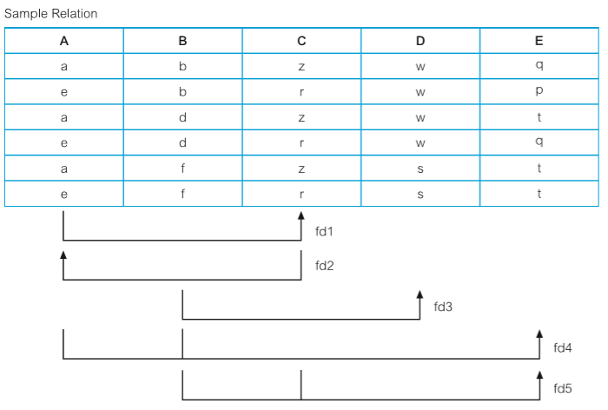
Identifying Functional Dependencies
The sample relation displaying data for attributes A,B,C,D and E and the functional dependencies (fd1 to fd4) that exist between these attributes.
A → C (fd1)
C → A (fd2)
B → D (fd3)
A, B → E (fd4)
B, C → E (fd5)

Slide 31
[SUMMARY]
Identifying Functional Dependency
To identify the functional dependencies that exist between attributes a, B, C, D, and E, we examine the Sample relation shown in Figure 14.6 and identify when values in one column are consistent with the presence of a particular value in other columns.
We begin with the first column on the left-hand side and work our way over to the right-hand side of the relation and then we look at combinations of columns; in other words, where values in two or more columns are consistent with the appearance of values in other columns.

Slide 32
PART 3: FIRST NORMAL FORM
INTRODUCTION
PART 1
DATA ANAMOLIES
PART 2
DEPENDENCIES
PART 3
FIRST NORMAL FORM
PART 4
SECOND NORMAL FORM
PART 5
THIRD NORMAL FORM
PART 6
BOYCE-CODD NORMAL FORM

Slide 33
The Process of Normalization
Formal technique for analyzing relations based on their primary key (or candidate keys) and functional dependencies.
Involves a series of rules that can be used to test each individual relations so that a database can be normalized to any degree.
A database is said to be a normalized database if all relations are in the “highest” normal form (usually 3NF onwards)
When a requirement is not met, the relation violating the requirement must be decomposed into relations that individually meet the requirements of normalization.
Checking rules begin with from 1NF, moving upward until at least 3NF (in this class we will cover until BCNF).

Slide 34
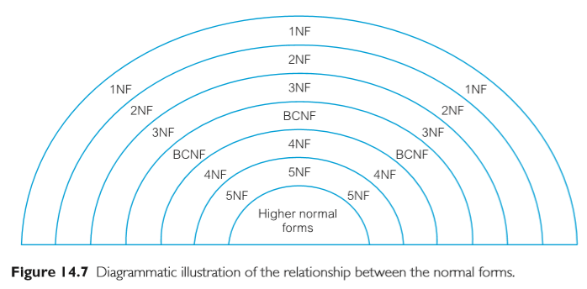
The Process of Normalization
Three normal forms:
  First Normal Form (1NF)
  Second Normal Form (2NF)
  Third Normal Form (3NF)

Slide 35
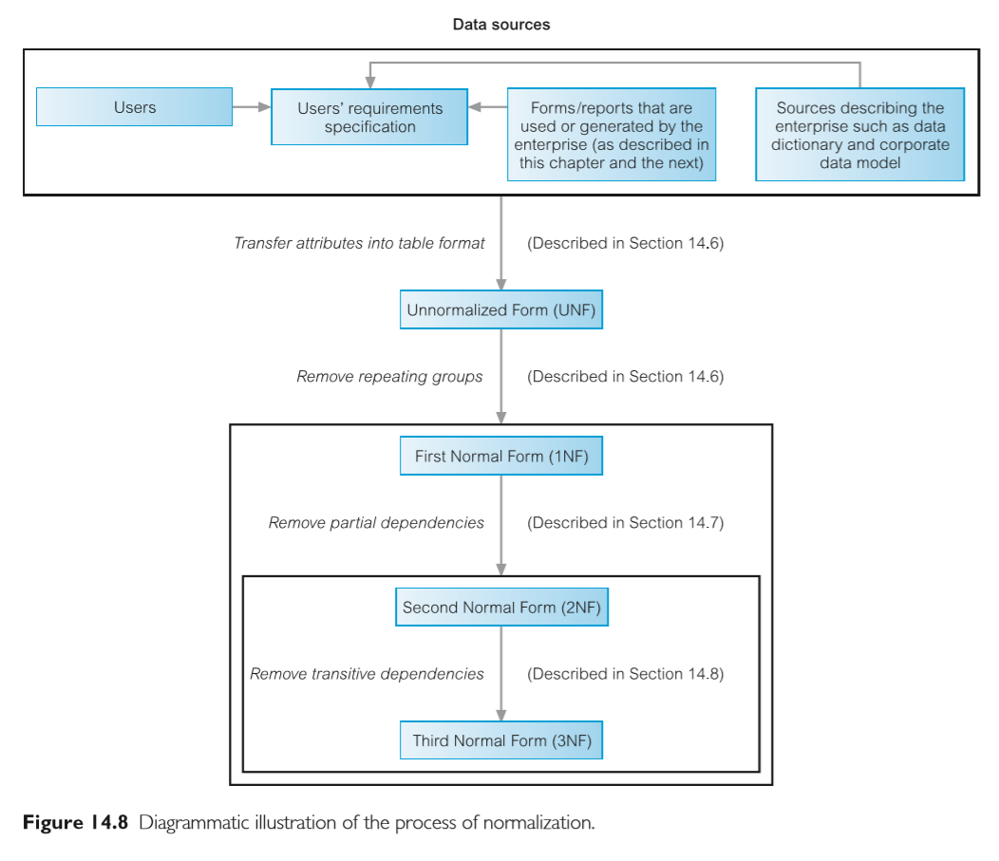

Slide 36
First Normal Form (1NF)
Before the process of normalization, data from source table could be in unnormalized form (UNF), which is a table that contains one or more repeating groups.
1NF – A relation in which the intersection of each row and column contains one and only one value.
Repeating group – is an attribute or group of attributes within a table that occurs with multiple values for a single occurrence of the nominated key attribute(s) for that table.
Two Approach to removing repeating groups from UNF:-
  By entering appropriate data in the empty columns of rows containing the repeating data ( 1st approach)
  By placing the repeating data, along with a copy of the original key attributes(s) in a separate relation. (2nd approach)

Slide 37
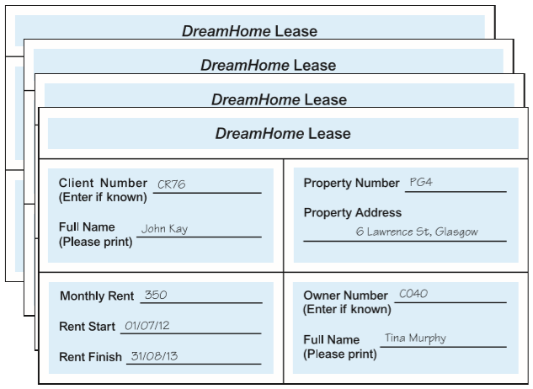
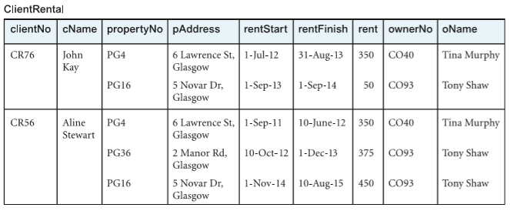
UNF: Example
Collection of DreamHome leases
Repeating Groups
ClientRental Unnormalized table

Slide 38
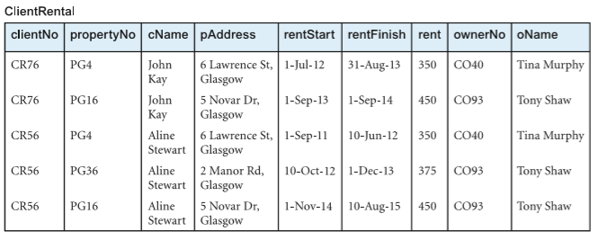
1NF Example: 1st Approach
Remove repeating group in UNF table (property rented details) by entering the appropriate client data into each row.
1NF relation schema:
ClientRental (clientNo, propertyNo, cName, pAddress, rentStart, rentFinish, rent, ownerNo, oName)

Slide 39
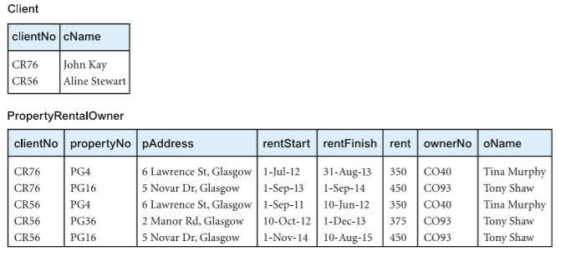
1NF Example: 2nd Approach
Remove repeating group (property rented details) in 1NF table with a copy of the original key attribute(i.e. the PK - clientNo) by replacing them in a separate relation from the non-repeating group relation. Name both relations appropriately.
2 newly formed 1NF relations with a single value at the intersection of each row:
1NF relation schema:
Client (clientNo, cName)
PropertyRentalOwner (clientNo, propertyNo, pAddress, rentStart, rentFinish, rent, ownerNo, oName)

Slide 40
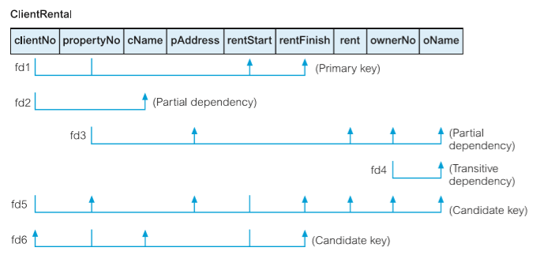
1NF: Determine Primary Key (PK)
ClientRental (clientNo, propertyNo, cName, pAddress, rentStart, rentFinish, rent, ownerNo, oName)

Slide 41
First Normal Form (1NF)
Important Notes:
If you are using normalization as a validation technique to validate relations that are derived from conceptual ERM, we can safely say that the derived relations are already in 1NF, where the assumption is a row of record in the relation is considered as one complete tuple.
Already in 1NF
Starts with UNF

Slide 42
Summary
1NF: removing repeating group
2NF: removing partial dependency
3NF: removing transitive dependency
BCNF: removing non-candidate key determinant
Identify PK & dependencies within the relation

Slide 43
PART 4: SECOND NORMAL FORM
INTRODUCTION
PART 1
DATA ANAMOLIES
PART 2
DEPENDENCIES
PART 3
FIRST NORMAL FORM
PART 4
SECOND NORMAL FORM
PART 5
THIRD NORMAL FORM
PART 6
BOYCE-CODD NORMAL FORM

Slide 44
Second Normal Form (2NF)
2NF: A relation that is in first normal form and every non-primary-key attribute is fully functionally dependent on the primary key.
A 1NF relation with a single attribute PK is automatically a 2NF relation.
A 1NF relation with composite PK MAY or MAY NOT BE a 2NF relation.
The normalization of 1NF relations to 2NF involves the removal of partial dependencies.
  If a partial dependency exists, remove the partially dependent attribute(s) from the relation by replacing them in a new relation along with a copy of determinant

Slide 45
1NF to 2NF: What to do?
Identify the functional dependencies in the relation.
Observe the FDs, if partial dependencies exist on the primary key, move all partial dependencies attributes from the relation by placing them in a new relation along with a copy of their determinant.

Slide 46
2NF Example
Let us use the 1NF ClientRental relation (obtained from the 1st approach).
  list its FDs
  determine the PK for ClientRental

Slide 47
2NF Example
FDs list in ClientRental
FD1 : clientNo, propertyNo 🡪 rentStart, rentFinish
FD2 : clientNo 🡪 cName
FD3 : propertyNo 🡪 pAddress, rent, ownerNo, oName
FD4 : ownerNo 🡪 oName
FD5 : clientNo, rentStart 🡪 propertyNo, pAddress, rentFinish, rent, ownerNo, oName
FD6 : propertyNo, rentStart 🡪 clientNo, cName, rentFinish

Slide 48
2NF Example
Identify FDs with existence of partial dependencies on PK
  Is there any FD such that the determinant is a subset of PK?
  If so, then that FD is not a Full FD, hence the relation violates the 2NF rule.
PK is clientNo, propertyNo
Subsets of PK:
  {clientNo}, {propertyNo}, {clientNo, propertyNo}
determinant in FD2 and FD3 is subset of PK
FDs list in ClientRental
FD1 : clientNo, propertyNo 🡪 rentStart, rentFinish
FD2 : clientNo 🡪 cName (partial dependency)
FD3 : propertyNo 🡪 pAddress, rent, ownerNo, oName (partial dependency)
FD4 : ownerNo 🡪 oName
FD5 : clientNo, rentStart 🡪 propertyNo, pAddress, rentFinish, rent, ownerNo, oName
FD6 : propertyNo, rentStart 🡪 clientNo, cName, rentFinish

Slide 49
2NF Example
3. Move all partial FDs attributes from the relation
  Create new relation for each partial FDs
  Name all relations appropriately
2NF Relations:
From FD2 : Client (clientNo, clientName)
From FD3 : PropertyOwner (propertyNo, pAddress, ownerNo, oName)
The rest : Rental (clientNo, propertyNo, rentStart, rentFinish)
These are our latest set of relations. All of them are now in 2NF as every non-PK attribute is fully FD on the PK of the relation

Slide 50
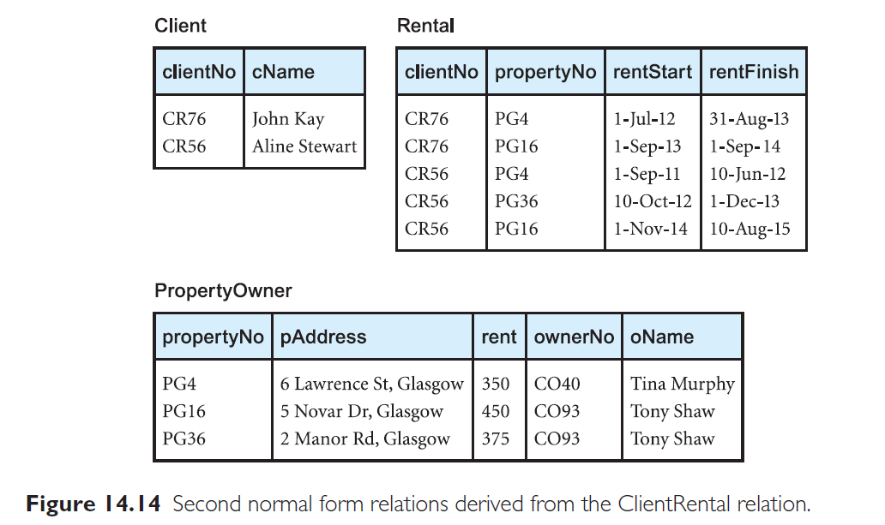

Slide 51
Summary
1NF: removing repeating group
2NF: removing partial dependency
3NF: removing transitive dependency
BCNF: removing non-candidate key determinant

Slide 52
PART 5: THIRD NORMAL FORM
INTRODUCTION
PART 1
DATA ANAMOLIES
PART 2
DEPENDENCIES
PART 3
FIRST NORMAL FORM
PART 4
SECOND NORMAL FORM
PART 5
THIRD NORMAL FORM
PART 6
BOYCE-CODD NORMAL FORM

Slide 53
Third Normal Form (3NF)
3NF: A relation that is in 1NF and 2NF and in which no non-primary key attribute is transitively dependent on the primary key.
2NF relations may still suffer from update anomalies.
This update anomaly is caused by a transitive dependency.
The normalization of 2NF into 3NF involves the removal of transitive dependency.
If a transitive dependency exists, move the transitively dependent attribute(s) from the relation by placing the attribute(s) in a new relation along with a copy of the determinant.

Slide 54
2NF to 3NF: What to do?
List FDs for all 2NF relations.
Examine each FDs by looking for transitive dependencies
If transitive dependencies exist on the primary key, remove them by placing them in a new relation along with a copy of their determinant.

Slide 55
3NF: Example
2NF relations:
Client (clientNo, clientName)
FD2 : clientNo → cName
Rental (clientNo, propertyNo, rentStart, rentFinish)
FD1 : clientNo, propertyNo → rentStart, rentFinish
FD5’ : clientNo, rentStart → propertyNo, rentFinish
FD6’ : propertyNo, rentStart → clientNo, rentFinish
PropertyOwner (propertyNo, pAddress, rent, ownerNo, oName)
FD3 : propertyNo → pAddress, rent, ownerNo, oName
FD4 : ownerNo → oName (Transitive dependency)
Look at PropertyOwner relation:
→ In FD3, propertyNo → ownerNo and propertyNo → oName
→ In FD4, ownerNo → oName
  → oName is TD on propertyNo via ownerNo

Slide 56
3NF: Example
Move transitive dependency attributes from PropertyOwner by placing the attributes in a new relation
  Owner (ownerNo, oName)
Rename the original relation (PropertyOwner) appropriately and place the remaining attributes
  PropertyForRent ( propertyNo, pAddress, rent, ownerNo)

Slide 57
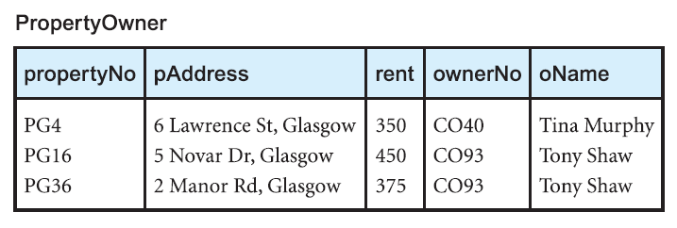
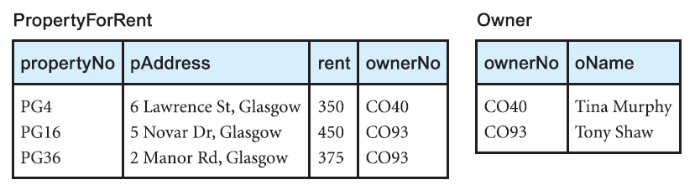
3NF: Example
PropertyOwner (2NF)
PropertyForRent (3NF)
Owner (3NF)

Slide 58
3NF: Example
These are our final set of normalized relations in the 3NF derived from the ClientRental relation.
  Client (clientNo, cName)
  Rental (clientNo, propertyNo, rentstart, rentFinish)
  PropertyForRent (propertyNo, pAddress, rent, ownerNo)
  Owner (ownerNo, oName)

Slide 59
Summary
1NF: removing repeating group
2NF: removing partial dependency
3NF: removing transitive dependency
BCNF: removing non-candidate key determinant

Slide 60
PART 6: BOYCE-CODD NORMAL FORM
INTRODUCTION
PART 1
DATA ANAMOLIES
PART 2
DEPENDENCIES
PART 3
FIRST NORMAL FORM
PART 4
SECOND NORMAL FORM
PART 5
THIRD NORMAL FORM
PART 6
BOYCE-CODD NORMAL FORM

Slide 61
Boyce-Codd Normal Form (BCNF)
Based on functional dependencies that take into account all candidate keys in a relation, however BCNF also has additional constraints compared with the general definition of 3NF.
Boyce–Codd normal form (BCNF)
  A relation is in BCNF if and only if every determinant is a candidate key.
determinant
NON-CANDIDATE KEY

Slide 62
Boyce-Codd Normal Form (BCNF)
Difference between 3NF and BCNF is that for a functional dependency A → B:
  3NF allows this dependency in a relation if B is a primary-key attribute and A is not a candidate key.
  Whereas BCNF insists that for this dependency to remain in a relation, A must be a candidate key.
Every relation in BCNF is also in 3NF. However, a relation in 3NF is not necessarily in BCNF.

Slide 63
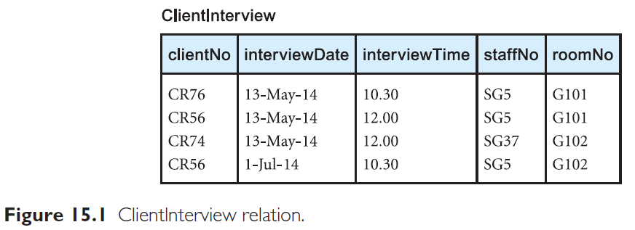
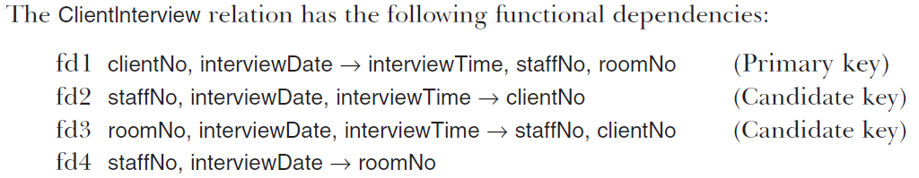
BCNF: Example
In this example, we extend the DreamHome case study to include a description of client interviews by members of staff.
Non-candidate key determinant
This relation is in 1NF, 2NF, 3NF, BUT NOT BCNF, because fd4 determinant is not a CK

Slide 64
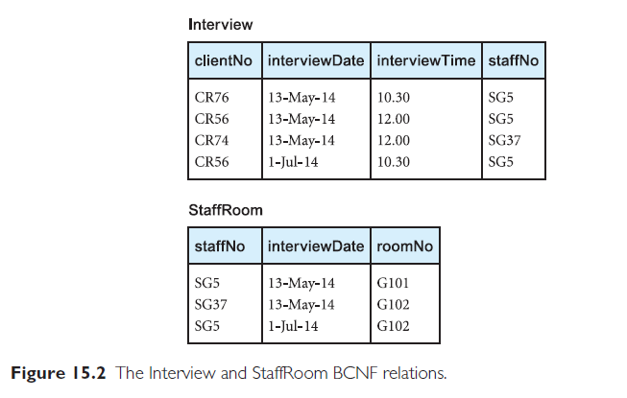
BCNF: Example

Slide 65
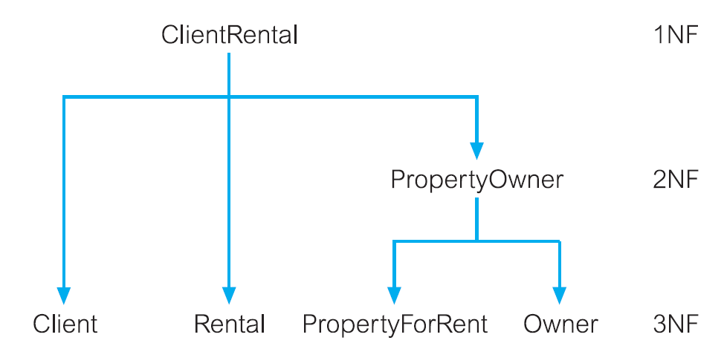
Example of dreamhome
Client
Rental
PropertyForRent
Owner
BCNF

Slide 66
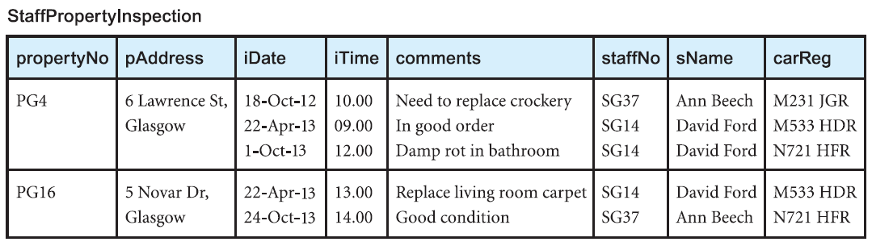
Another example
Given the following table, normalize up to BCNF.

Slide 67
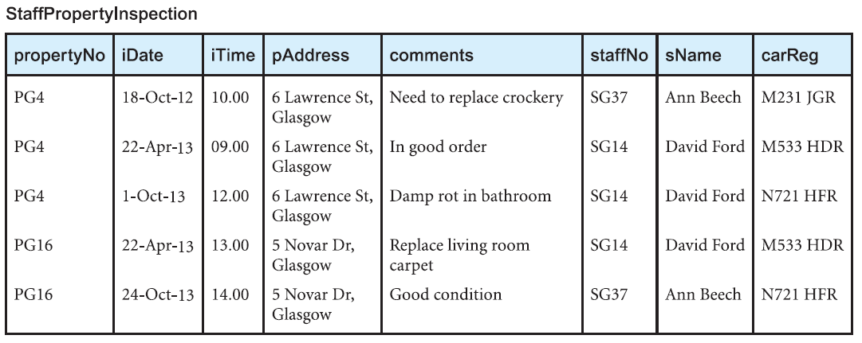
Another example
UNF to 1NF:
  StaffPropertylnspection (propertyNo, iDate, iTime, pAddress, comments, staffNo, sName, carReg)

Slide 68
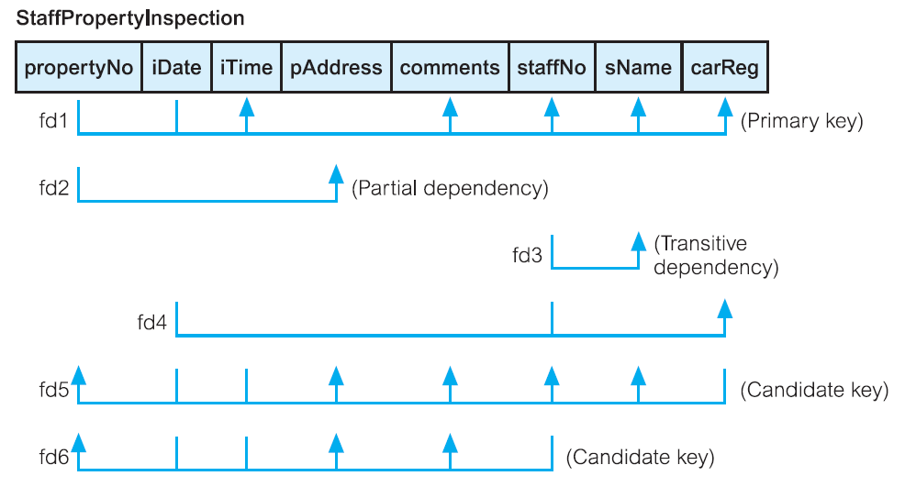
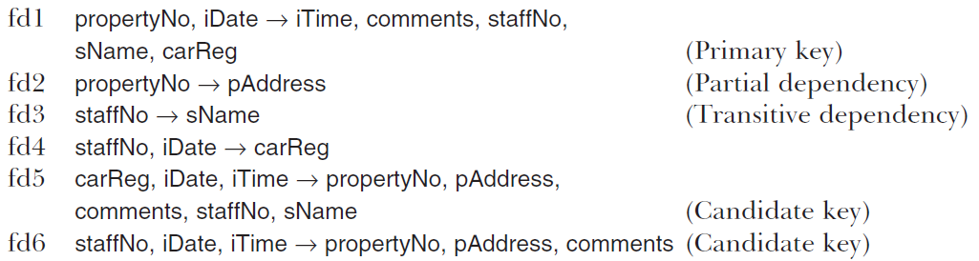
Another example
Dependency

Slide 69
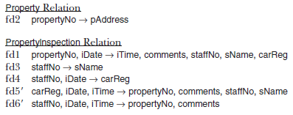
Another example
  1NF:
  StaffPropertylnspection (propertyNo, iDate, iTime, pAddress, comments, staffNo, sName, carReg)
  2NF:
  Propertylnspection (propertyNo, iDate, iTime, comments, staffNo, sName, carReg)
  Property (propertyNo, pAddress)
Transitive dependency

Slide 70
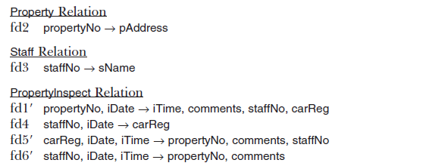
Another example
  3NF:
  Propertylnspection (propertyNo, iDate, iTime, comments, staffNo, carReg)
  Staff (staffNo, sName)
  Property (propertyNo, pAddress)
Non candidate key
  BCNF:
  lnspection (propertyNo, iDate, iTime, comments, staffNo)
  StaffCar (staffNo, iDate, carReg)
  Staff (staffNo, sName)
  Property (propertyNo, pAddress)

Slide 71
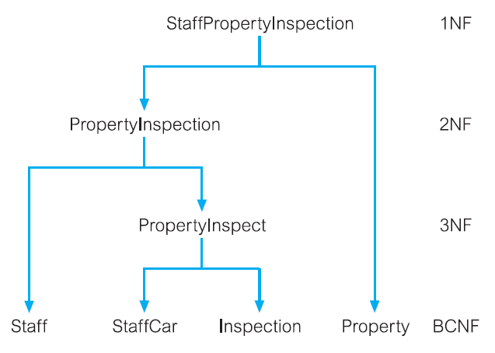
Another Example

Slide 72
Summary
1NF: removing repeating group
2NF: removing partial dependency
3NF: removing transitive dependency
BCNF: removing non-candidate key determinant

Slide 73


